Slide 1

MASTER’S DEGREE IN COMPUTER ENGINEERING
QUANTUM COMPUTING AND QUANTUM INTERNET
PROJECT DISCUSSION
E91 PROTOCOL
PROFESSORS
STUDENT
LUCIANO LENZINI
LEONARDO BACCIOTTINI
GIOVANNI LIGATO
UNIVERSITY OF PISA

Slide 2

MASTER’S DEGREE IN COMPUTER ENGINEERING
QUANTUM COMPUTING AND QUANTUM INTERNET
PROJECT DISCUSSION
E91 PROTOCOL
PROFESSORS
STUDENT
LUCIANO LENZINI
LEONARDO BACCIOTTINI
GIOVANNI LIGATO
UNIVERSITY OF PISA

Slide 3

INTRODUCTION
Securely sharing cryptographic keys over insecure channels is a fundamental challenge in modern cryptography.
BACKGROUND
Classical key distribution methods rely on computational hardness, which can be broken by advances in computing.
THE PROBLEM
The E91 protocol leverages quantum mechanics (entanglement and the no-cloning theorem) to enable infinitely secure key distribution, immune to eavesdropping.
SOLUTION

Slide 4

INTRODUCTION
MAYBE Follow:
Background
Problem statement,
Solution…
Do not represent the protocol from scratch…
INSECURE CHANNEL
EXCHANGE SECRET KEY ALICE AND BOB

Slide 5


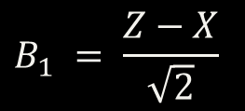
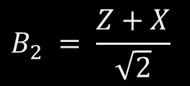
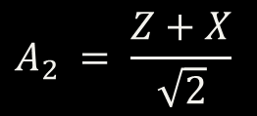

CHALLENGES
PROTOCOL DETAILS
ALICE
BOB
$$A_{0} = Z$$
$$B_{0} = Z$$
$$B_{1} = \frac{Z−X}{\sqrt{2}}$$
$$A_{1} = X$$
OBSERVABLES
$$A_{2} = \frac{Z+X}{\sqrt{2}}$$
$$B_{2} = \frac{Z+X}{\sqrt{2}}$$
CHSH CORRELATION VALUE
$$S= | \left\langle A_{0}B_{2} \right\rangle +\left\langle A_{0}B_{1} \right\rangle +\left\langle A_{1}B_{2} \right\rangle − ⟨ A_{1}B_{1} ⟩ |$$
The 0-indexed notation is used, as in the Python code, to avoid confusion between slides and implementation.

Slide 6







NOTEWORTHY IMPLEMENTATION STEPS
THEORY
1. DEFINE THE OBSERVABLE$O$
2. FIND ITS EIGENVALUES AND EIGENVECTORS
OBSERVABLE
${λ_{i} → \left|λ\right\rangle }_{i} =\left[\begin{matrix}λ_{i}^{(1)} \\ λ_{i}^{(2)}\end{matrix}\right] i=1,2$
3. DETERMINE THE UNITARY TRANSFORMATION MAPPING
EIGENVECTORS TO STANDARD BASIS STATES
HERMITIAN MATRIX
$$\left[\begin{matrix}λ_{1}^{(1)} & λ_{1}^{(2)} & 0 & 0 \\ 0 & 0 & λ_{1}^{(1)} & λ_{1}^{(2)} \\ λ_{2}^{(1)} & λ_{2}^{(2)} & 0 & 0 \\ 0 & 0 & λ_{2}^{(1)} & λ_{2}^{(2)}\end{matrix}\right]⋅\left[\begin{matrix}a \\ b \\ c \\ d\end{matrix}\right]=\left[\begin{matrix}1 \\ 0 \\ 0 \\ 1\end{matrix}\right]$$
$$|0⟩$$
REAL EIGENVALUES
$$|1⟩$$
4. VERIFY THE FOUND MATRIX IS UNITARY
CAN BE DISPLAYED ON THE MEASURING DEVICE
$$U=\left[\begin{matrix}a & b \\ c & d\end{matrix}\right] → UU^{†}=U^{†}U=I$$
5. APPLY THE UNITARY TRANSFORMATION TO THE QUBIT AND
MEASURE IN THE STANDARD BASIS
MEASUREMENT CAUSES COLLAPSE INTO ONE OF THE EIGENSPACES ASSOCIATED WITH THE RELATIVE EIGENVALUE.
$$|ψ⟩$$
$U$
THIS ENTIRE PROCESS ENABLES
MEASUREMENT AS IF USING THE ORIGINAL OBSERVABLE$O$

Slide 7
SCENARIOS TO ANALYZE
1. IDEAL CONDITIONS
2. CHANNEL ERROS
3. EAVESDROPPING

Slide 8


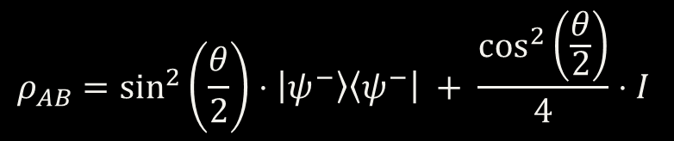








THE SPECIALIZED CIRCUIT FOR GENERATING WERNER STATES
CONTROLLED BY CHARLIE
$${|0⟩}_{A}$$
$$R_{y}(θ)$$
$H$
$${|0⟩}_{B}$$
+
$X$
$H$
$$0_{C}$$
$$C=1$$
$$C=0$$
$$C=1$$
$$C=0$$
$$ρ_{AB}=\sin^{2}\left(\frac{θ}{2}\right)⋅\left|ψ^{−}\right\rangle \left\langle ψ^{−}\right| + \frac{\cos^{2}\left(\frac{θ}{2}\right)}{4}⋅I$$

Slide 9
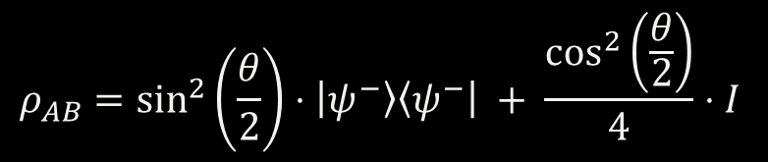


$$ρ_{AB}=\sin^{2}\left(\frac{θ}{2}\right)⋅\left|ψ^{−}\right\rangle \left\langle ψ^{−}\right| + \frac{\cos^{2}\left(\frac{θ}{2}\right)}{4}⋅I$$
THIS IS A WERNER STATE WHEN THE WERNER PARAMETER ($w$) IS SET TO
$$w=\sin^{2}\left(\frac{θ}{2}\right) → ρ_{AB} = w⋅\left|ψ^{−}\right\rangle \left\langle ψ^{−}\right| + \frac{1−w}{4}⋅I$$
THE FIDELITY CAN BE OBTAINED FROM THE WERNER PARAMETER USING THE FOLLOWING FORMULA:
$$F=\frac{3w+1 }{4}$$

Slide 10
1. IDEAL CONDITIONS

Slide 11
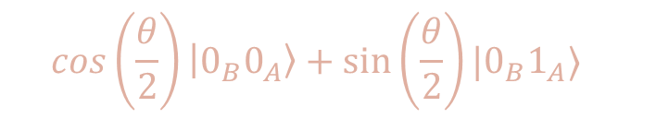


$${|0⟩}_{A}$$
$$R_{y}(θ)$$
$H$
$${|0⟩}_{B}$$
+
$X$
$H$
$$0_{C}$$
$$C=1$$
$$C=0$$
$$C=1$$
$$C=0$$
$$\cos\left(\frac{θ}{2}\right)\left|0_{B}0_{A}\right\rangle +\sin\left(\frac{θ}{2}\right)|0_{B}1_{A}⟩$$
$$P\left\{0_{A}\right\}=\cos^{2}\left(\frac{θ}{2}\right)$$
MEASUREMENT PROBABILITIES FOR ALICE’S QUBIT
$$P\left\{1_{A}\right\}=\sin^{2}\left(\frac{θ}{2}\right)$$

Slide 12



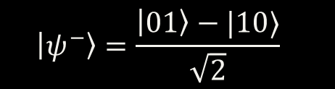



IN THE IDEAL CASE, SETTING $θ=π$ SIMPLIFIES THE CIRCUIT AS FOLLOWS
(AFTER MEASURING ALICE'S QUBIT)
$$P\left\{1_{A}\right\}=\sin^{2}\left(\frac{π}{2}\right)=1$$
$$P\left\{0_{A}\right\}=\cos^{2}\left(\frac{π}{2}\right)=0$$
$${|1⟩}_{A}$$
$H$
$$\left|ψ^{−}\right\rangle =\frac{\left|01\right\rangle −|10⟩}{\sqrt{2}}$$
$${|0⟩}_{B}$$
+
$X$
BELL GATE

Slide 13
2. CHANNEL ERROS

Slide 14

IN THE PRESENCE OF CHANNEL ERRORS, THEY ARE SIMULATED USING THE GENERAL CIRCUIT PREVIOUSLY ILLUSTRATED, WITH THE FOLLOWING $θ$ VALUES:
$$0≤θ<π$$
NOTE THAT WHEN $θ=0$, THE OUTPUT OF THE CIRCUIT WILL BE A COMPLETELY DEPOLARIZED STATE.

Slide 15
3. EAVESDROPPING

Slide 16








IN THE EAVESDROPPING SCENARIO EVE TAKES CONTROL OF THE SITE-GENERATING ENTANGLED PHOTON PAIRS
$${|0⟩}_{A}$$
$X$
$$\frac{1}{2}$$
$$|0_{B}1_{A}⟩$$
$${|0⟩}_{B}$$
EVE SENDS ONE OF THE FOLLOWING TWO STATES TO ALICE AND BOB WITH EQUAL PROBABILITY (1/2), INSTEAD OF AN ENTANGLED PAIR OF PHOTONS.
$${|0⟩}_{A}$$
$$|1_{B}0_{A}⟩$$
$$\frac{1}{2}$$
$${|0⟩}_{B}$$
$X$

Slide 17
IDEAL CONDITIONS
RESULTS
ALL THE PLOTS required in the project specifications

Slide 18
METRICS TO EVALUATE
S e Rmis al variare di theta

Slide 19
CHANNEL ERRORS
EXPLAIN HOW THEY ARE INTRODUCED VIA THE SPECIALIZED CIRCUIT
ADD THE SCREEN OF THE CIRCUIT AND FORMULAS…
$$w⋅\left|ψ^{−}\right\rangle \left\langle ψ^{−}\right| + \frac{1−w}{4}⋅I$$
$$R_{mis}=\frac{\#mismatchedbits}{totalkeylength }$$

Slide 20

EXPERIMENT PARAMETERS
n
NUMBER OF EXECUTIONS PER SETTING
$$θ$$
THETA VALUES USED FOR GENERATING THE WERNER STATES
Eavesdropping
WHETHER EVE IS EAVESDROPPING OR NOT
#EPR Pairs
NUMBER OF EPR PAIRS GENERATED IN ONE PROTOCOL EXECUTION

Slide 21

EXPERIMENT PARAMETERS
n
NUMBER OF EXECUTIONS PER SETTING
$$θ$$
THETA VALUES USED FOR GENERATING THE WERNER STATES
Eavesdropping
WHETHER EVE IS EAVESDROPPING OR NOT
#EPR Pairs
NUMBER OF EPR PAIRS GENERATED IN ONE PROTOCOL EXECUTION

Slide 22

n
NUMBER OF EXECUTIONS PER SETTING
$$θ$$
THETA VALUES USED FOR GENERATING THE WERNER STATES
EXPERIMENT PARAMETERS
Eavesdropping
WHETHER EVE IS EAVESDROPPING OR NOT
#EPR Pairs
NUMBER OF EPR PAIRS GENERATED IN ONE PROTOCOL EXECUTION

Slide 23








EXPERIMENT CONFIGURATION
RESULTS WITH FOLLOWIN SETTING:
# Number of times the protocol is executed for each setting
n = 30
# Theta values to be used for the generation of the Werner States
theta_values = np.linspace(0, np.pi, 15)
# Whether Eve is eavesdropping or not
eavesdropping = False
# Number of EPR pairs to be generated in one execution of the protocol
epr_pairs = 300
n$→$30
$θ→\left[\frac{i}{14}π | i=0,1, …, 14\right]$
Eavesdropping $→$False
#EPR Pairs $→$ 300
n$→$30
$θ→\left[\frac{i}{14}π | i=0,1, …, 14\right]$
Eavesdropping $→$False
#EPR Pairs $→$ 300

Slide 24
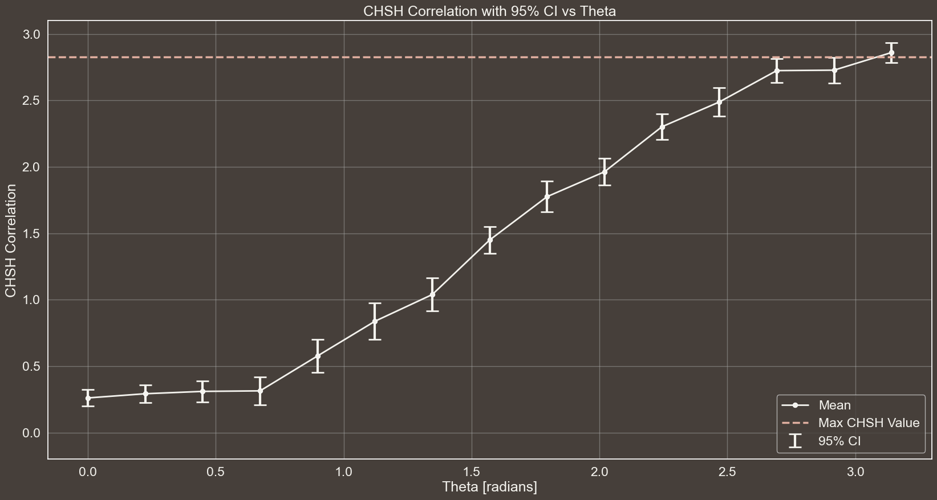
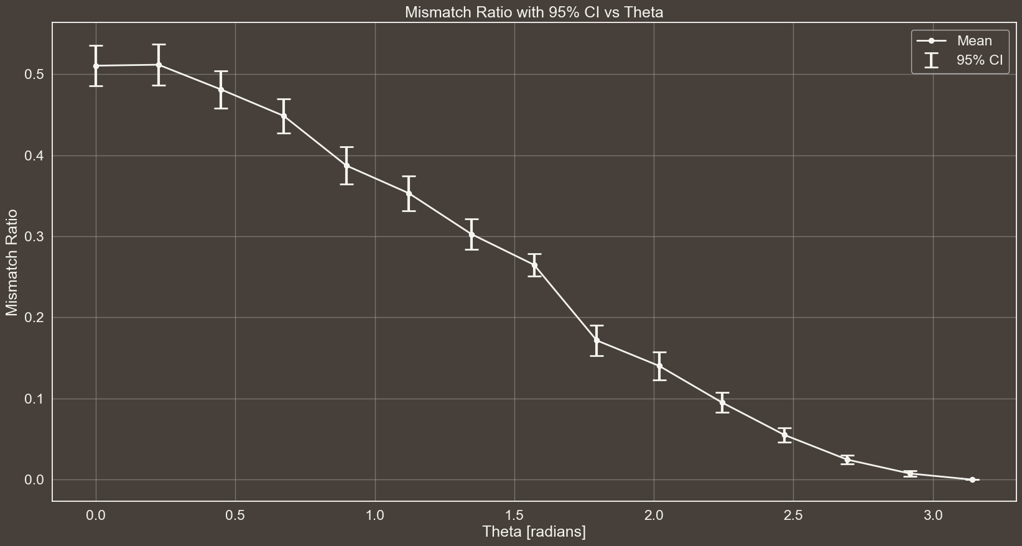



CHSH CORRELATION WITH 95% CI vs THETA
n$→$30
$θ→\left[\frac{i}{14}π | i=0,1, …, 14\right]$
Eavesdropping $→$False
#EPR Pairs $→$ 300

Slide 25




CHSH CORRELATION WITH 95% CI vs THETA
n$→$30
$θ→\left[\frac{i}{14}π | i=0,1, …, 14\right]$
Eavesdropping $→$False
#EPR Pairs $→$ 300

Slide 26
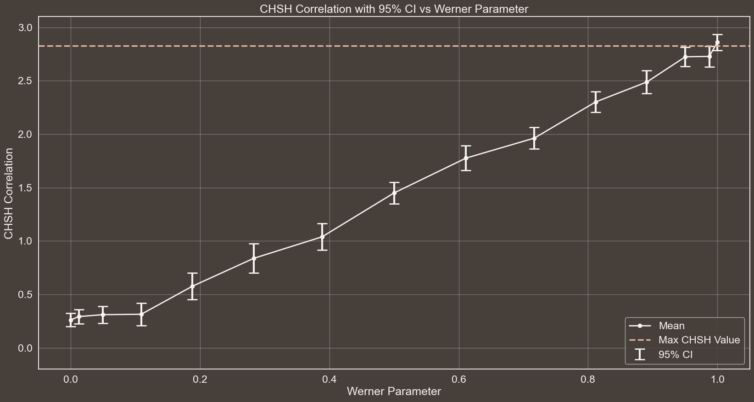
CHSH CORRELATION WITH 95% CI vs WERNER PARAMETER
n$→$30
$θ→\left[\frac{i}{14}π | i=0,1, …, 14\right]$
Eavesdropping $→$False
#EPR Pairs $→$ 300

Slide 27
MISMATCH RATIO WITH 95% CI vs THETA
n$→$30
$θ→\left[\frac{i}{14}π | i=0,1, …, 14\right]$
Eavesdropping $→$False
#EPR Pairs $→$ 300

Slide 28
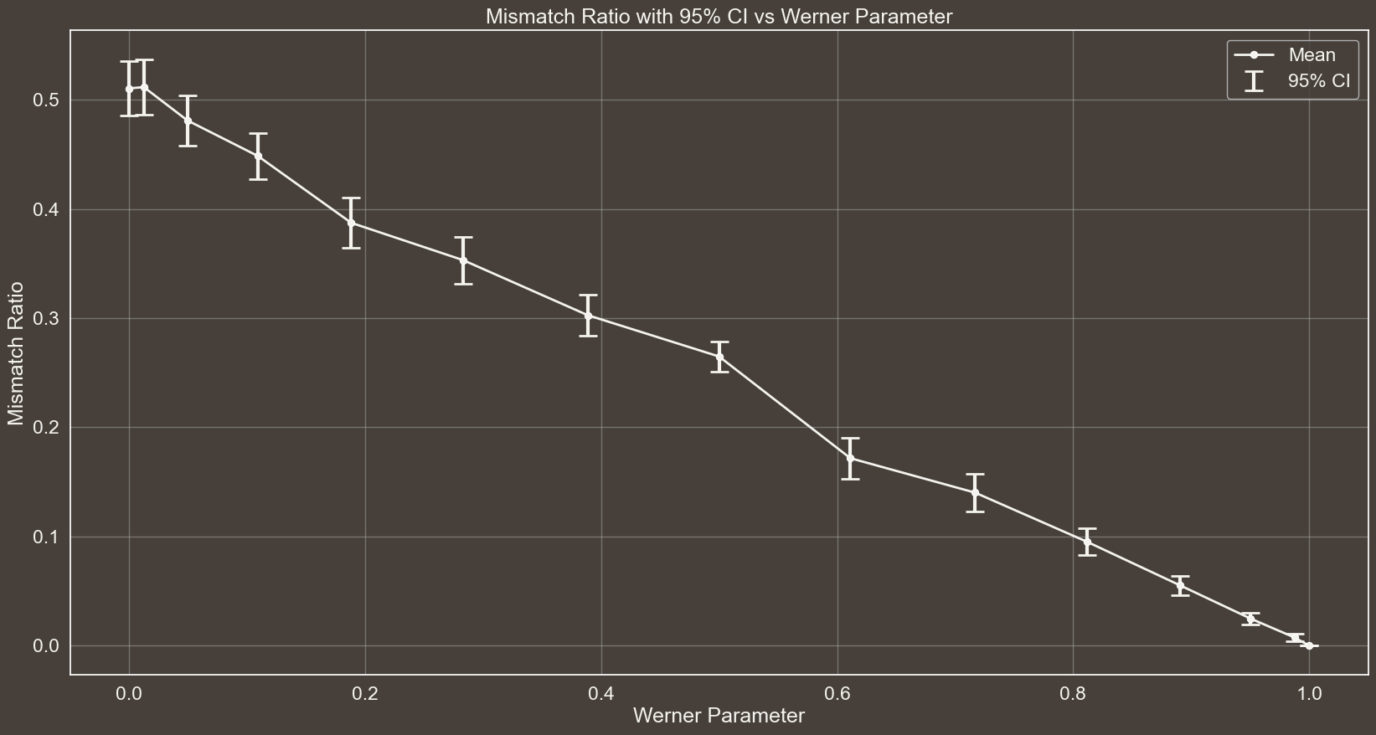
MISMATCH RATIO WITH 95% CI vs WERNER PARAMETER
n$→$30
$θ→\left[\frac{i}{14}π | i=0,1, …, 14\right]$
Eavesdropping $→$False
#EPR Pairs $→$ 300

Slide 29


RESULTS WITH FOLLOWIN SETTING:
# Number of times the protocol is executed for each setting
n = 30
# Theta values to be used for the generation of the Werner States
theta_values = np.linspace(0, np.pi, 15)
# Whether Eve is eavesdropping or not
eavesdropping = False
# Number of EPR pairs to be generated in one execution of the protocol
epr_pairs = 1000
n$→$30
$θ→\left[\frac{i}{14}π | i=0,1, …, 14\right]$
Eavesdropping $→$False
#EPR Pairs $→$ 1000

Slide 30
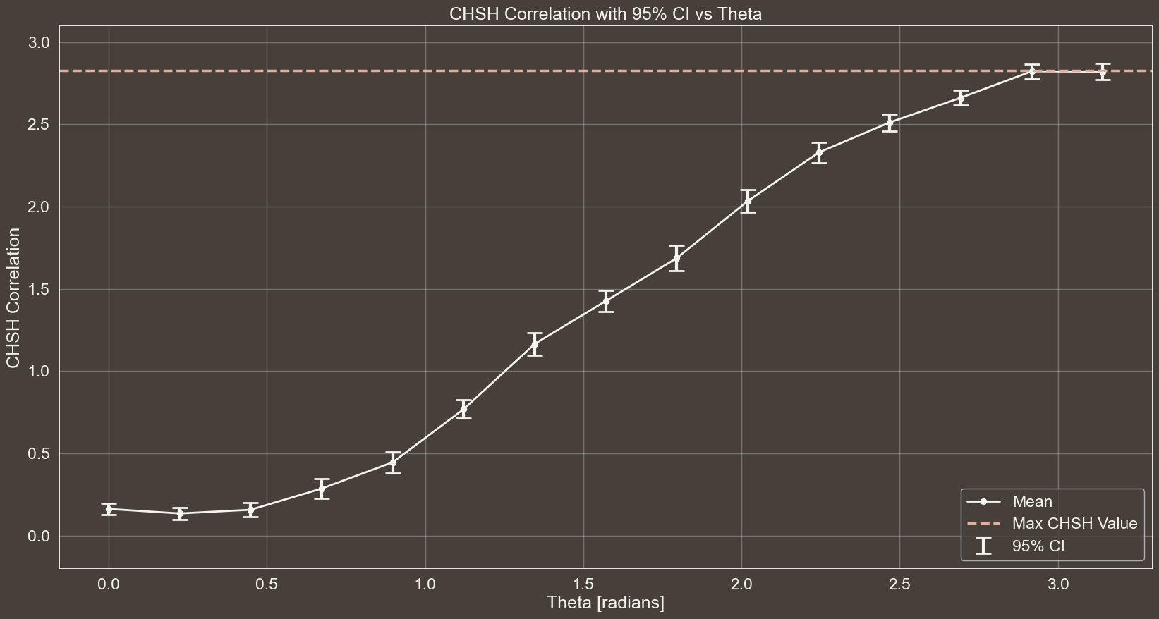
CHSH CORRELATION WITH 95% CI vs THETA
n$→$30
$θ→\left[\frac{i}{14}π | i=0,1, …, 14\right]$
Eavesdropping $→$False
#EPR Pairs $→$ 1000

Slide 31
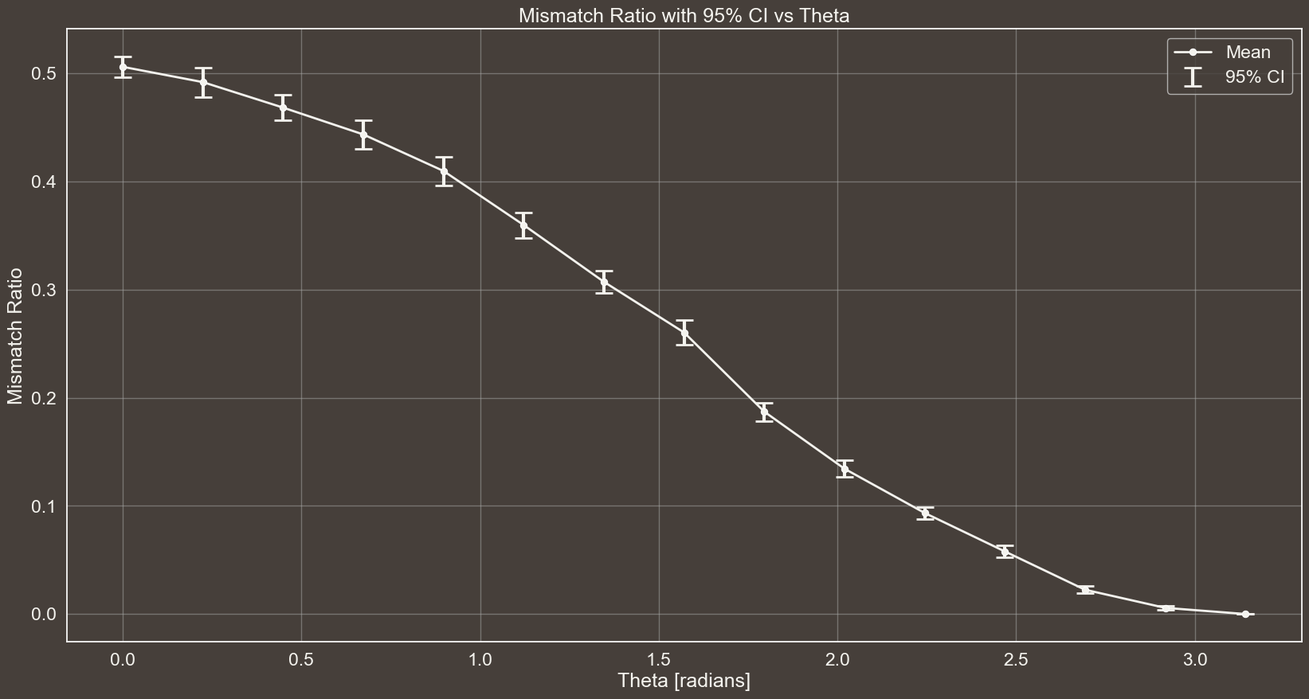
MISMATCH RATIO WITH 95% CI vs THETA
n$→$30
$θ→\left[\frac{i}{14}π | i=0,1, …, 14\right]$
Eavesdropping $→$False
#EPR Pairs $→$ 1000

Slide 32
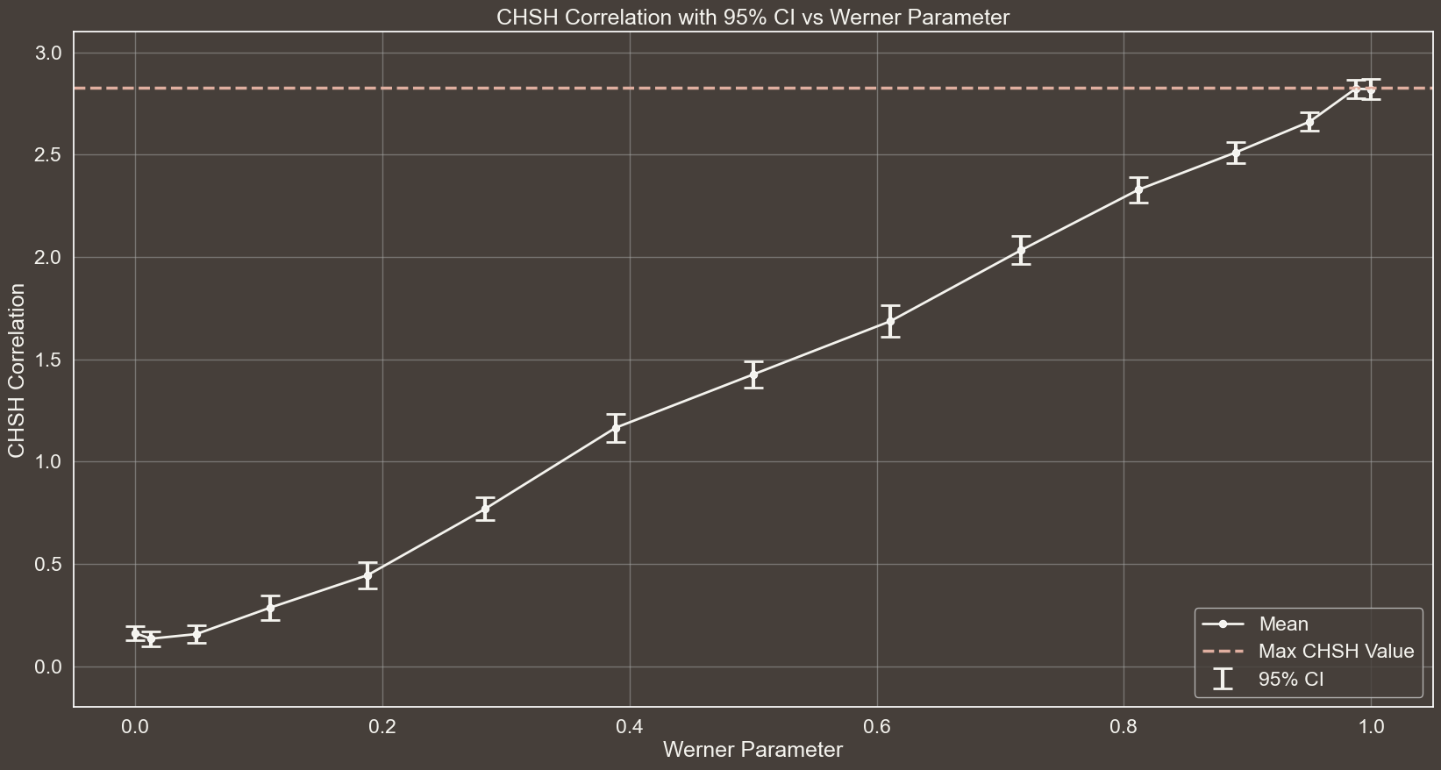
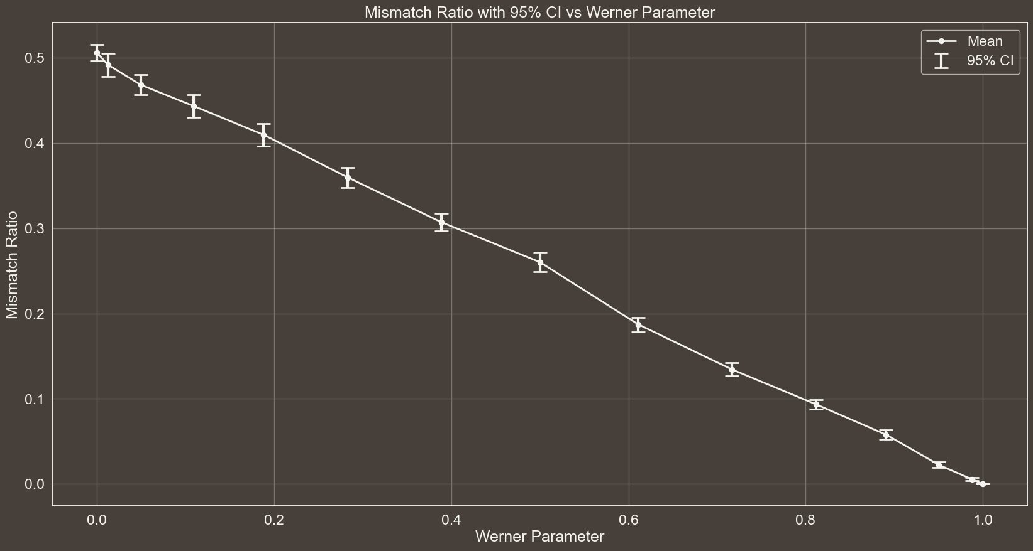

Slide 33




EXPLORING THE EFFECT OF #EPR PAIRS VARIATION
n$→$30
$θ→\left[\frac{i}{14}π | i=0,1, …, 14\right]$
Eavesdropping $→$False
#EPR Pairs $→$ 1000

Slide 34


RESULTS WITH FOLLOWIN SETTING:
# Number of times the protocol is executed for each setting
n = 30
# Theta values to be used for the generation of the Werner States
theta_values = np.linspace(0, np.pi, 15)
# Whether Eve is eavesdropping or not
eavesdropping = False
# Number of EPR pairs to be generated in one execution of the protocol
epr_pairs = 80
n$→$30
$θ→\left[\frac{i}{14}π | i=0,1, …, 14\right]$
Eavesdropping $→$False
#EPR Pairs $→$ 80

Slide 35
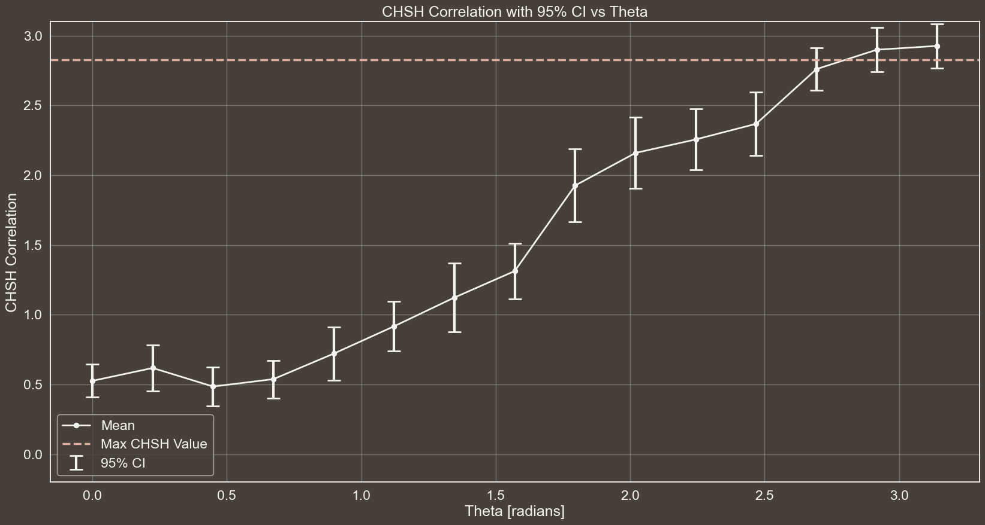
CHSH CORRELATION WITH 95% CI vs THETA
n$→$30
$θ→\left[\frac{i}{14}π | i=0,1, …, 14\right]$
Eavesdropping $→$False
#EPR Pairs $→$ 80

Slide 36
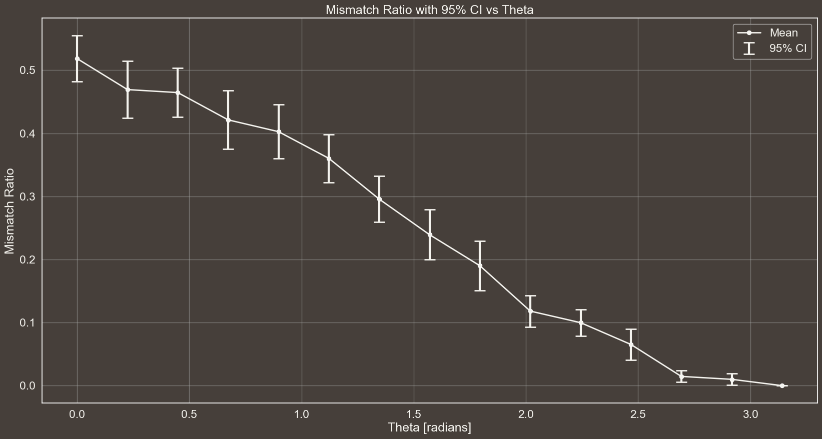
MISMATCH RATIO WITH 95% CI vs THETA
n$→$30
$θ→\left[\frac{i}{14}π | i=0,1, …, 14\right]$
Eavesdropping $→$False
#EPR Pairs $→$ 80

Slide 37

n$→$30
$θ→\left[\frac{i}{14}π | i=0,1, …, 14\right]$
Eavesdropping $→$False
#EPR Pairs $→$ 80

Slide 38
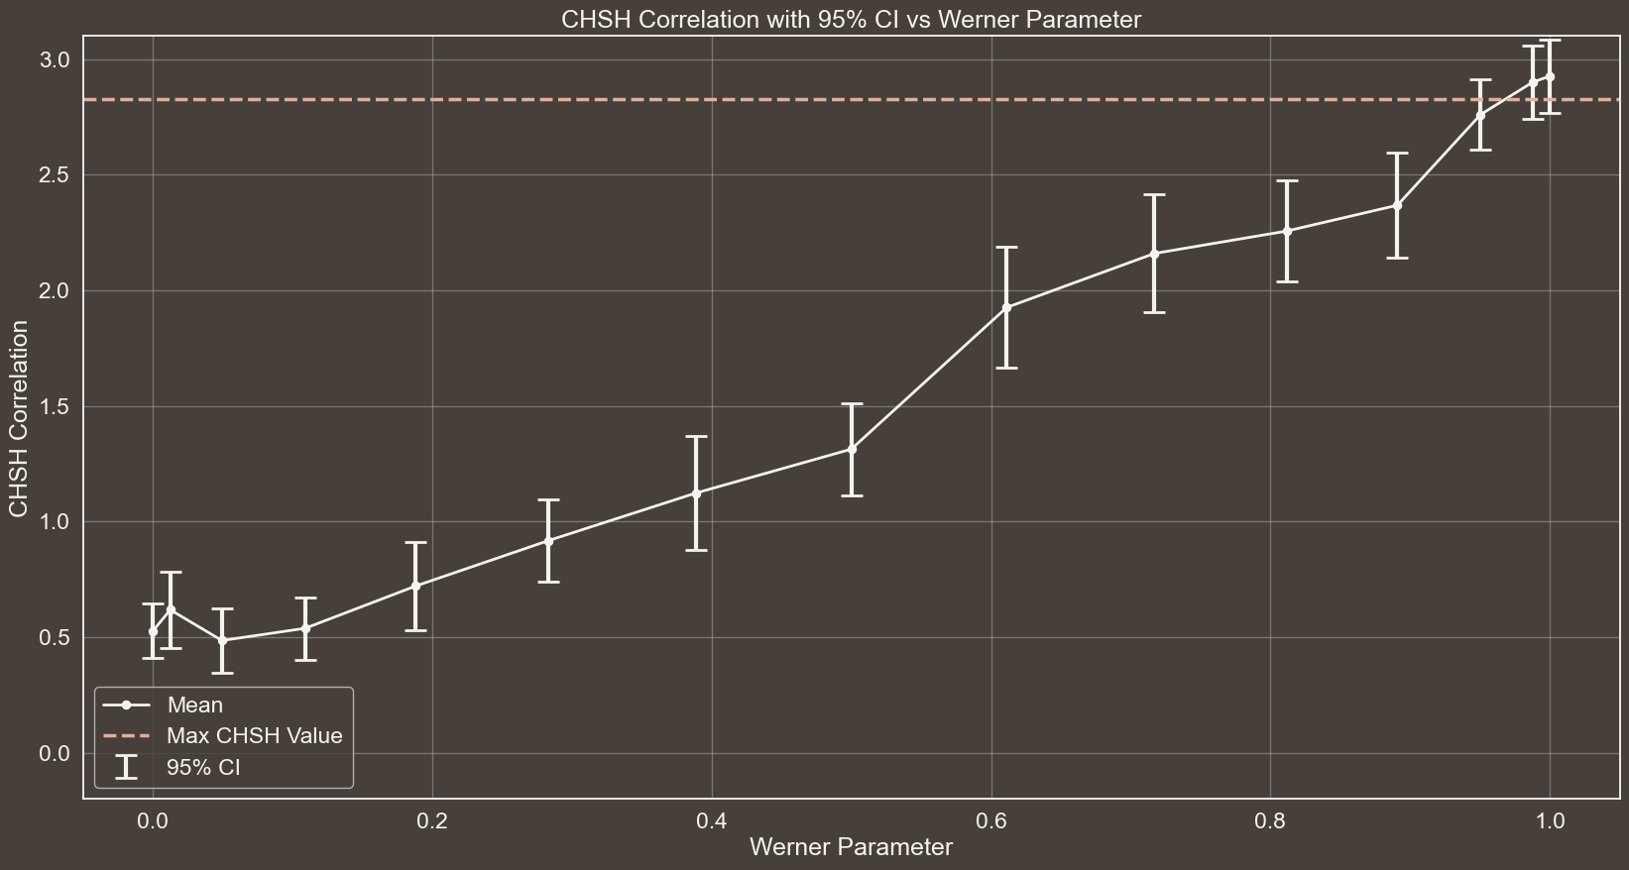
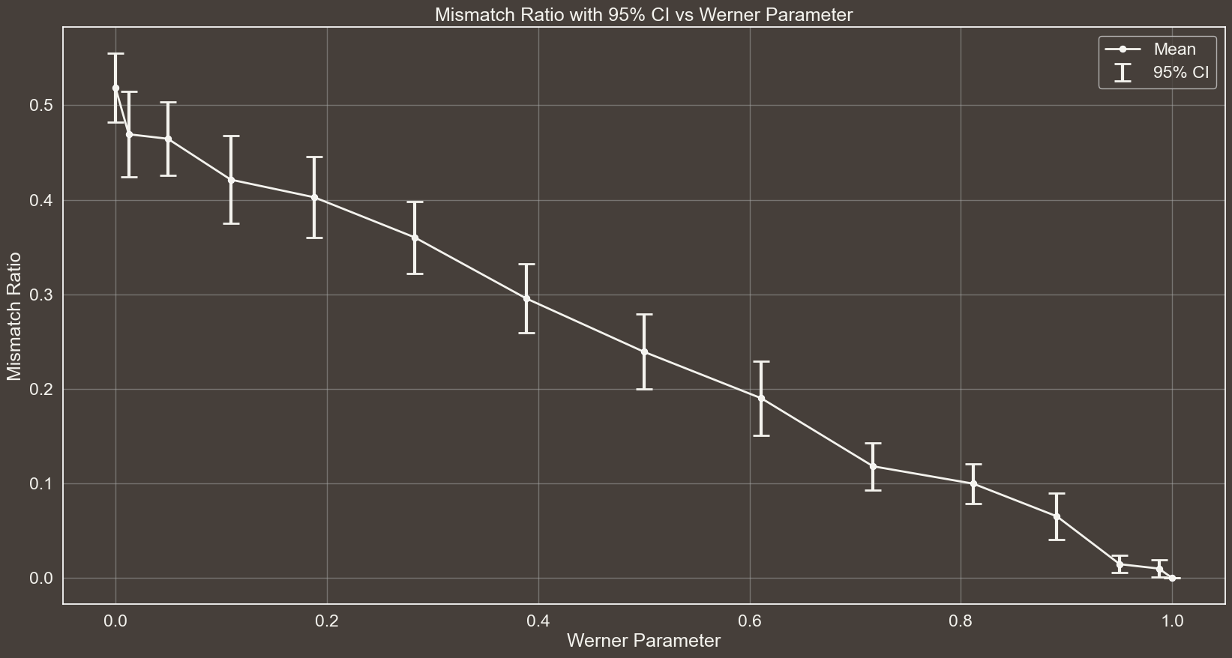

Slide 39




RESULTS WITH FOLLOWIN SETTING:
# Number of times the protocol is executed for each setting
n = 30
# Theta values to be used for the generation of the Werner States
theta_values = [np.pi] # np.linspace(0, np.pi, 15)
# Whether Eve is eavesdropping or not
eavesdropping = True
# Number of EPR pairs to be generated in one execution of the protocol
epr_pairs = 300
n$→$30
$θ→\left[π\right]$
Eavesdropping $→$True
#EPR Pairs $→$ 300

Slide 40

IN caso di eavesdropping si verificano degli errori tra le chaivi di alice e bob per il seguente motivo. Eve invia a Alcie e Bob solamente o |01> o |10>. Se loro misurano entrambi in Z non succeed nulla, ma se misurano in base WW, cosa succeed? Vediamolo subito.
Per misurare in base WW, si applica la seguente trasformazione U ad entrambi I qubit e poi si misura In base Z
$$\left[\begin{matrix}0.924 & 0.383 \\ −0.383 & 0.924\end{matrix}\right]$$
Consideriamo ad esempio caso in cui Eve manda |10>, per l’altro caso si procede in modo analogo.
$\left|10\right\rangle ⋅\left(U⨂U\right)=\left(0.383 | 0\right\rangle +0.924|1⟩) ⨂ (0.924\left|0\right\rangle −0.383|1⟩)=0.354|00⟩−0.147|01⟩+0.854|10⟩−0.354|11⟩$
Perciò effettivamente si posson ottenere tutti e 4 gli outcome, ed in particolare quando escono |00> e |11> si hanno risultati correlate e non anticorrelate e dunque si ha un errore nella generazione della chiave. In particolare la probabilità che si abbiano quesi errori è:
Considerando che WW è solo una delle due scelte possibili per la generazione della chiave (moltiplicando per ½ ) si ottiene la probabilità totale di avere errori nella chiave: 0.125
Perciò si dovrebbe avere un mismatch ratio di questo valore…
$0.354^{2}+0.354^{2}=0.251$
Risultati arrotondati a 3 cifre decimali qui nelle slide per una questione di presentazione, su python non si approssimano a così poche cifre, ma si considerano molte di più per Maggiore accuratezza.

Slide 41
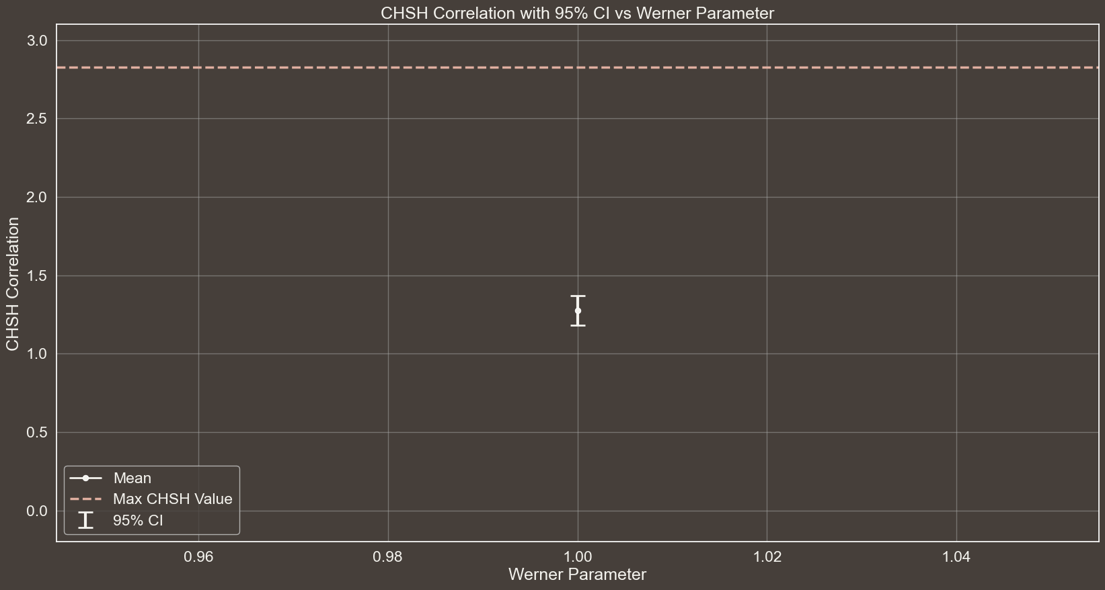
CHSH CORRELATION WITH 95% CI vs WERNER PARAMETER
n$→$30
$θ→\left[π\right]$
Eavesdropping $→$True
#EPR Pairs $→$ 300

Slide 42
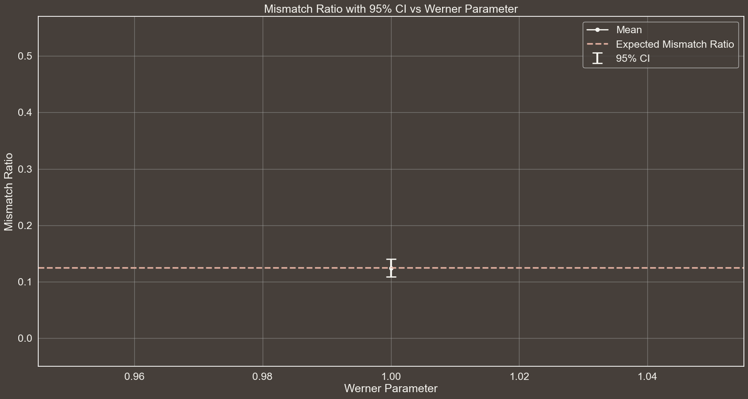
MISMATCH RATIO WITH 95% CI vs WERNER PARAMETER
n$→$30
$θ→\left[π\right]$
Eavesdropping $→$True
#EPR Pairs $→$ 300

Slide 43



EAVESDROPPING
GRAPH OF S WITH CI THAT IS BELOW 2sqrt(2)
Spiegare a cosa sono dovuti gli errori in questo caso… Il fatto che se misuro in base W e ho 01 o 10 allora posso ottenere tutti gli outcome con diverse probabilità
$$|01⟩$$
$$\frac{1}{2}$$
$$|10⟩$$

Slide 44
REFERENCES
[1]
CHSH INEQUALITY
https://en.wikipedia.org/wiki/CHSH_inequality
[2]
QUANTUM CORRELATION
https://en.wikipedia.org/wiki/Quantum_correlation
[3]
TSIRELSON'S BOUND
https://en.wikipedia.org/wiki/Tsirelson's_bound
Notes:
Didi Chuxing implementa il monitoraggio telemetrico della guida (algoritmo di machine learning per verificare frenate brusche, accelerazioni brusche e altri parametri che definiscono una guida pericolosa.

Slide 45


REFERENCES
[1]
CHSH INEQUALITY
https://en.wikipedia.org/wiki/CHSH_inequality
https://coolors.co/palette/463f3a-8a817c-bcb8b1-f4f3ee-e0afa0
[2]
QUANTUM CORRELATION
https://en.wikipedia.org/wiki/Quantum_correlation
[3]
TSIRELSON'S BOUND
https://en.wikipedia.org/wiki/Tsirelson's_bound
www.flaticon.com
Notes:
Didi Chuxing implementa il monitoraggio telemetrico della guida (algoritmo di machine learning per verificare frenate brusche, accelerazioni brusche e altri parametri che definiscono una guida pericolosa.

Slide 46
THANKS
FOR YOUR ATTENTION

Slide 47

MASTER’S DEGREE IN COMPUTER ENGINEERING
INTELLIGENT SYSTEMS
PROJECT DISCUSSION
Comparative Analysis of Deep Learning Models for Brain Tumor Segmentation in MRI Images
PROFESSORS
STUDENT
PIETRO DUCANGE
FABRIZIO RUFFINI
GIOVANNI LIGATO
University of Pisa

Slide 48

Brain Tumors directly impair Brain function, affecting cognition, mood and personality.
Timely detection of these Tumors is crucial, as recognizing the initial stages of a Brain Tumor can profoundly influence a patient’s prognosis.
BACKGROUND
Reading and interpreting MRI scans is an intricate process. Indeed, it is estimated that in 5-10% of scans, a relevant Pathology is missed.
THE PROBLEM
Intelligent Systems to automatically identify and segment Regions Of Interest (ROI).
SOLUTION

Slide 49
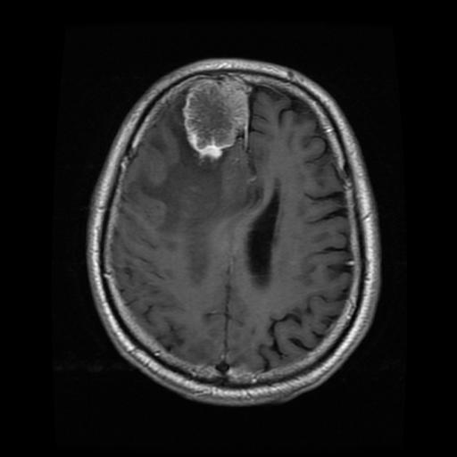


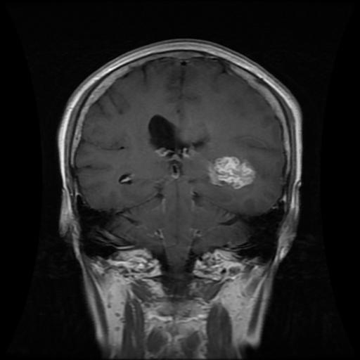


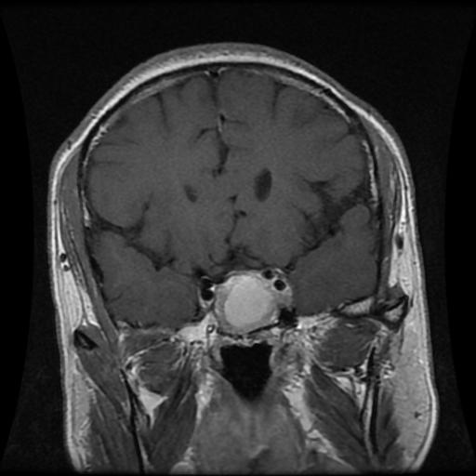


DATASET
MENINGIOMA
708
Collected from two Hospitals in China between 2005 and 2010.
GLIOMA
1426
233 Patients
PITUITARY
930
The Tumor regions were manually segmented by three experienced radiologists.

Slide 50


YOLOv8n-seg 3.4
YOLOv8s-seg 11.8
YOLOv8
YOLOv8m-seg 27.3
YOLOv8l-seg 46.0
YOLO
YOLOv8x-seg 71.8
DEEP LEARNING MODELS
YOLOv9c-seg 27.9
YOLOv9
YOLOv9e-seg 60.5
U-Net
1.94
Region Growing
0
CLASSICAL ALGORITHM
THIS COLOR SHOWS THE MODEL'S COMPLEXITY IN MILLIONS OF PARAMETERS

Slide 51
MAIN
.
2 | X ∩ Y |
EVALUATION
=
DICE SCORE
METRIC
| X | + | Y |
It measures the similarity between two samples and is used to compare algorithm outputs against reference masks, particularly in medical applications.

Slide 52




EXPERIMENTAL ANALYSIS
WORKFLOW
DATASET PREPARATION
TRAINING
RESULTS
5 FOLD CROSS-VALIDATION

Slide 53
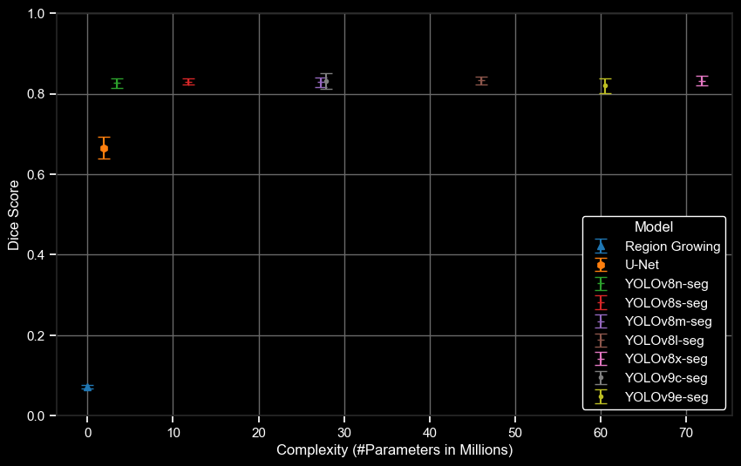
SEGMENTATION RESULTS
Dice Score
Complexity (#Parameters in Millions)

Slide 54
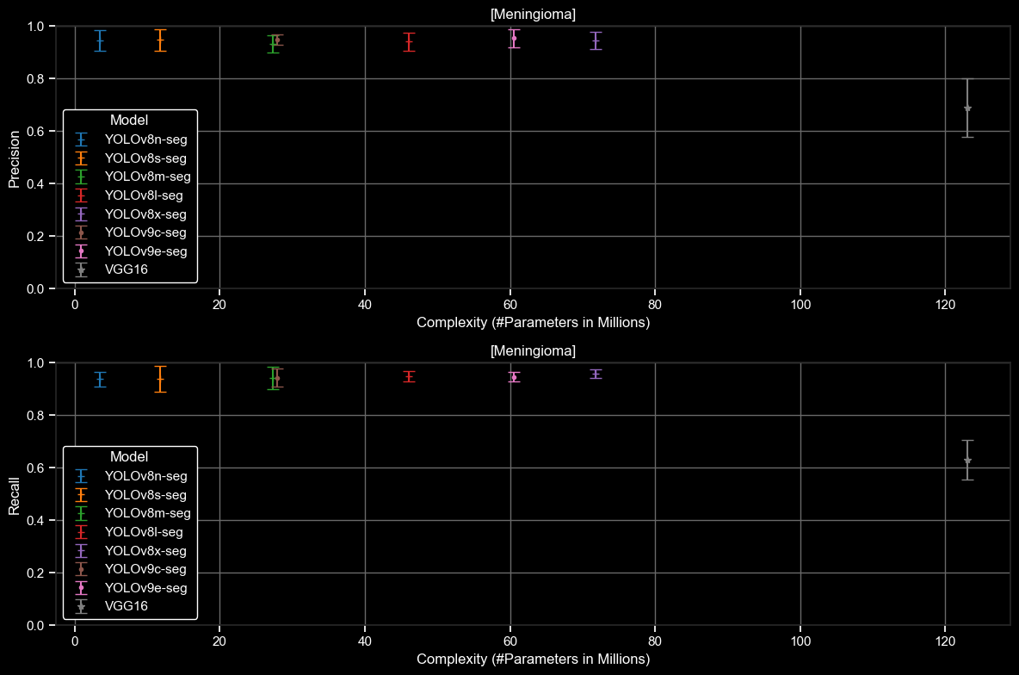
CLASSIFICATION RESULTS
MENINGIOMA

Slide 55
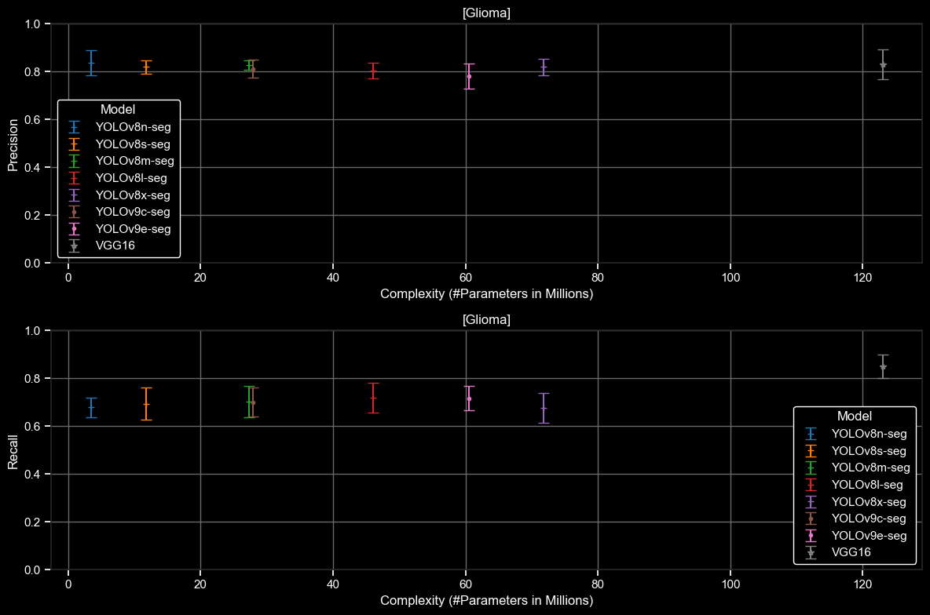
CLASSIFICATION RESULTS
GLIOMA

Slide 56
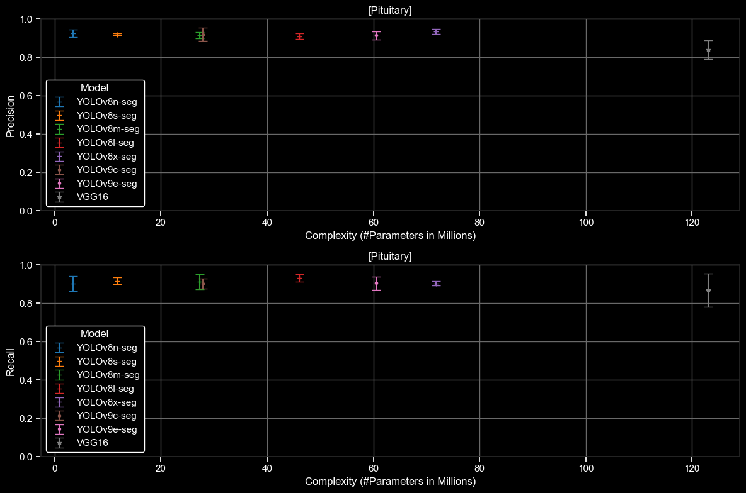
CLASSIFICATION RESULTS
PITUITARY

